Slide 1

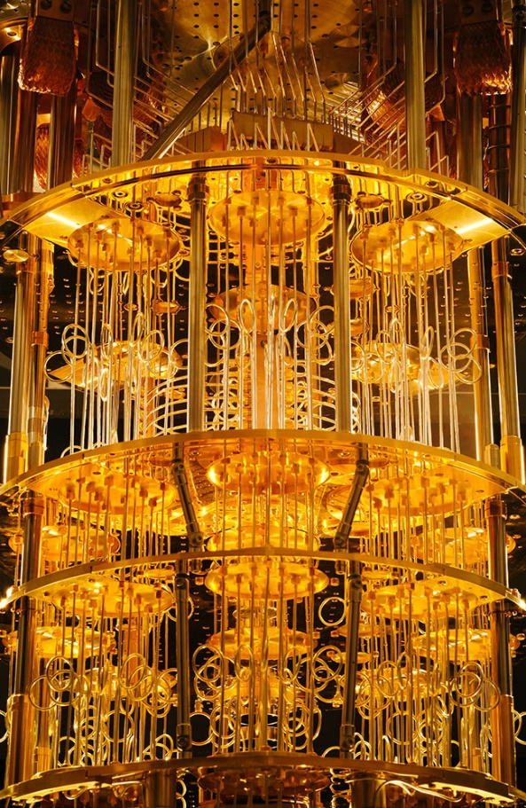
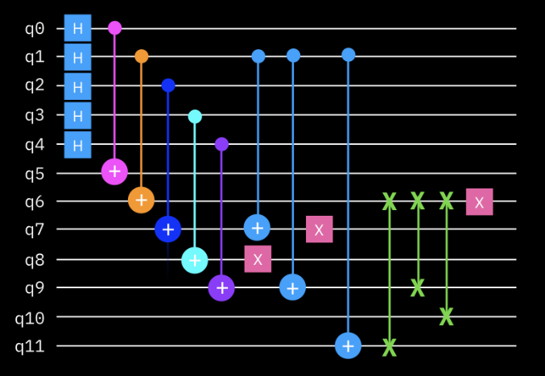
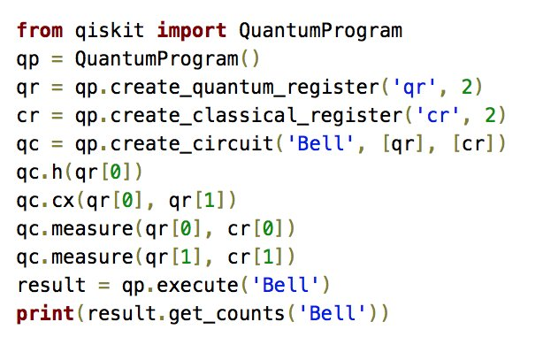
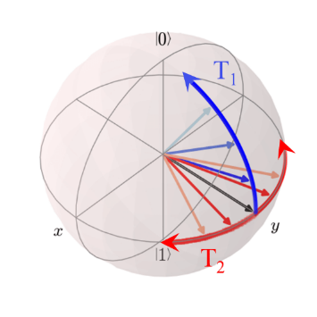

Foundations of
Quantum Information Science (QIS 101)
Dave Biersach
Brookhaven National Laboratory
dbiersach@bnl.gov
Session 14b
Linear Algebra

Slide 2
Session 14b – Goals
Create a 2D maze on graph paper
Understand how to encode the cell walls in base 2
Learn how bitwise operators can decode a wall value
Perform file input / output using CSV and binary formats
Appreciate backtracking in depth-first search algorithm
Implement breadcrumbs using a stack data structure
Understand how an adjacency matrix can improve depth-first search efficiency

Slide 3
Maze Solver
Write a program that will find a path from the entrance to the exit of a given maze
The maze should be created using a simple encoding
During the search, the program cannot receive any hints from humans – it must run autonomously
The maze is 10x10 cells, and must have at least one open path from entrance to exit cell
The complete maze perimeter must not have any holes – all outside edges must be walls

Slide 4
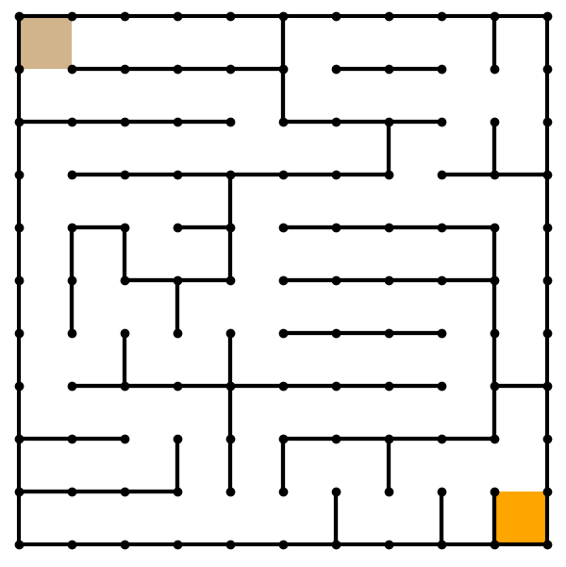
0
1
2
3
4
5
6
7
8
9
0
10 Rows
10 Cols
Y = Rows
X = Cols
Positive Y is down!
Entrance = [0][0]
Exit
= [9][9]
1
2
This is a just a sample.
You will design and encode your own maze!
3
4
5
6
7
8
9

Slide 5
How do we encode a maze?
Encode each wall position as an increasing power of 2
Consider how to describe each individual square (cell) within the maze
How can we indicate for each individual cell if a wall exists to the North, East, South, or West direction?
North = 1
West = 8
East = 2
South = 4

Slide 6
How do we encode a maze?
If a wall exists in a direction, add the value of that direction to the total cell value
North = 1
9
West = 8
East = 2
South = 4

Slide 7
How do we encode a maze?
Using a power of 2 for each wall value produces an unambiguous encoding of all wall permutations
0 ≤ cell value ≤ 15
No walls = zero (0)
15 = a totally “walled-in” cell that is unreachable (Hint: don’t make a cell = 15)
North = 1
7
West = 8
East = 2
South = 4

Slide 8
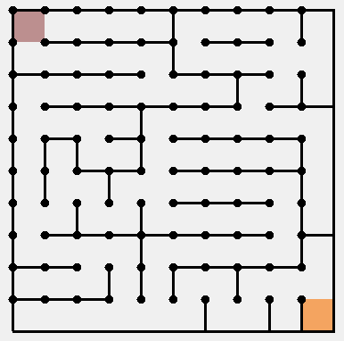
0
1
2
3
4
5
6
7
8
9
0
9
5
5
5
7
9
5
5
3
11
1
12
5
5
5
3
12
5
5
0
2
2
9
5
5
5
4
5
7
9
6
14
3
8
5
1
7
9
5
5
4
5
3
4
10
11
12
7
8
5
5
5
7
10
5
10
8
3
9
0
5
5
5
3
10
6
8
6
12
6
12
5
5
5
2
14
7
12
5
1
3
9
5
5
5
6
11
8
13
5
6
10
10
9
3
9
1
2
9
13
5
5
4
4
6
12
6
14
14

Slide 9
Drawing the 2D Maze
Given a maze initialized with Base 2 wall encodings, how can we draw it?
We could use a long series of if() statements to test all 16 possible values for a cell, and draw the required walls
However, this would be inefficient in code size and run time
We can take advantage of bitwise AND to figure out what walls to draw for a given cell

Slide 10
Bitwise Operators
Bitwise operators use single ampersand or pipe character
Bitwise X and Y values: X & Y
Bitwise X or Y values: X | Y
Logical operators only return True or False
Bitwise operators return an integer value
You normally only perform bitwise operations with int types

Slide 11
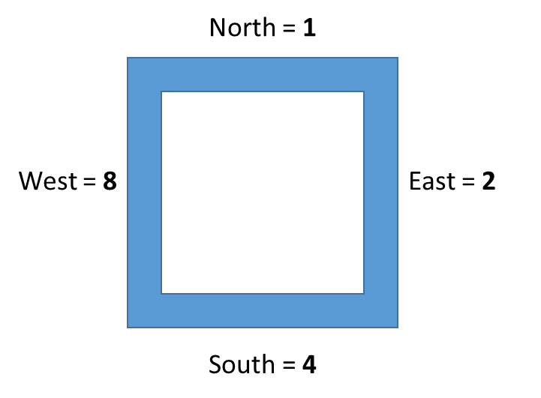
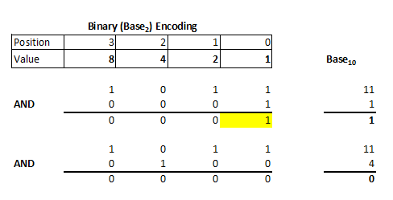
Bitwise AND
11

Slide 12
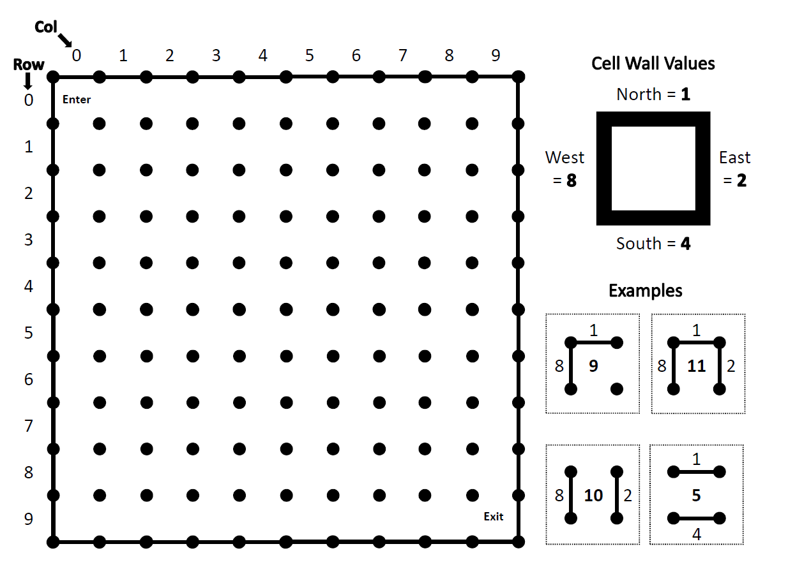
Draw and Encode Your Own Maze
Blank Maze Template.pdf
10 Rows
10 Cols
Y = Rows
X = Cols
Positive Y is down!
Entrance = [0][0]
Exit
= [9][9]

Slide 13
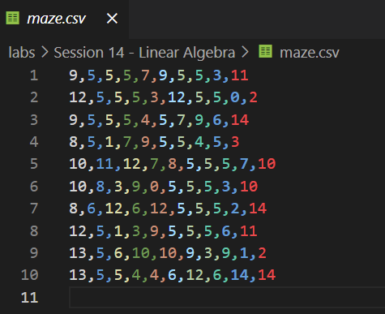
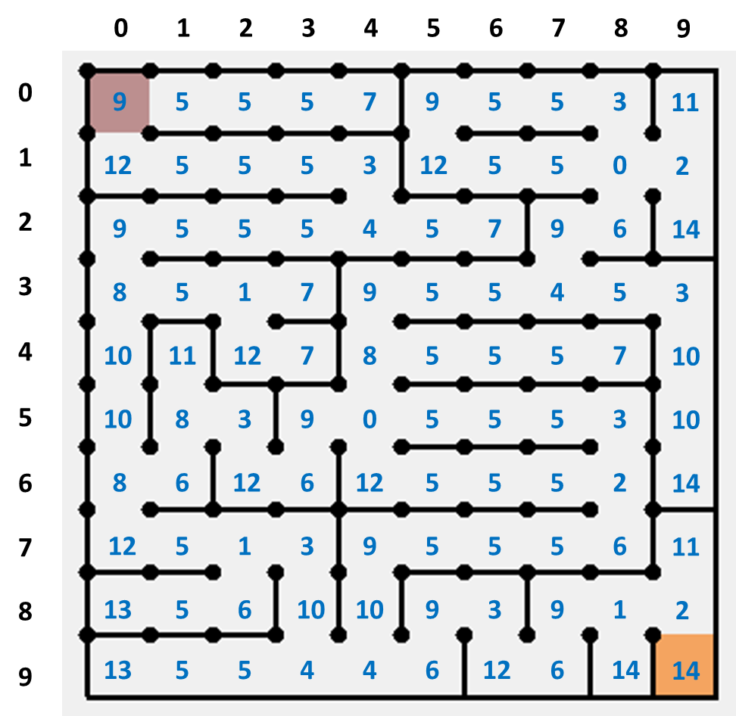
Create Your Own maze.csv
10 Rows
10 Cols
Y = Rows
X = Cols
Positive Y is down!
Entrance = [0][0]
Exit
= [9][9]

Slide 14
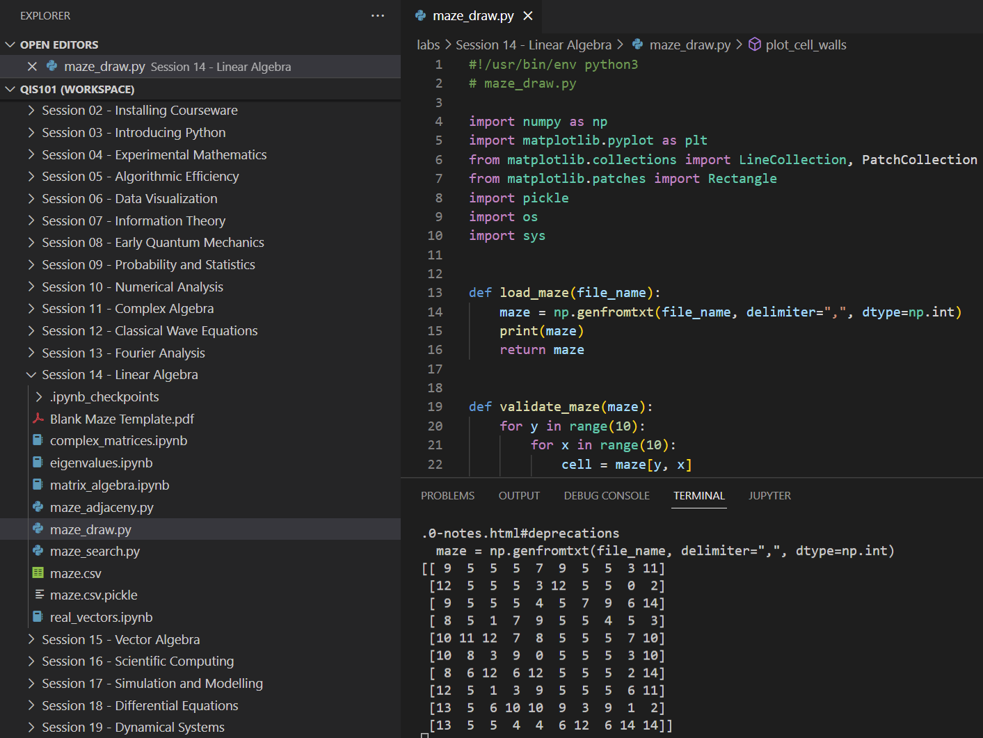
Run maze_draw.py
②
①
③

Slide 15
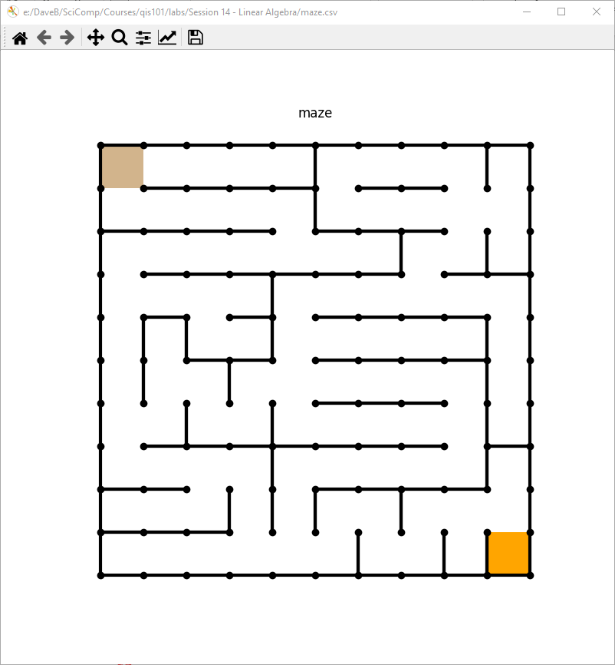
If Your maze.csv is Valid…

Slide 16
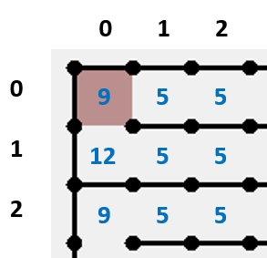
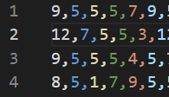
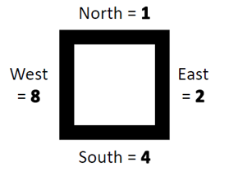
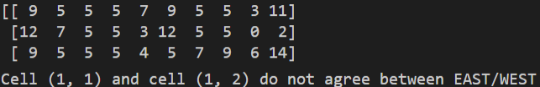
If Your maze.csv is Not Valid…
Error in Transcribing Encoded Cell Value

Slide 17
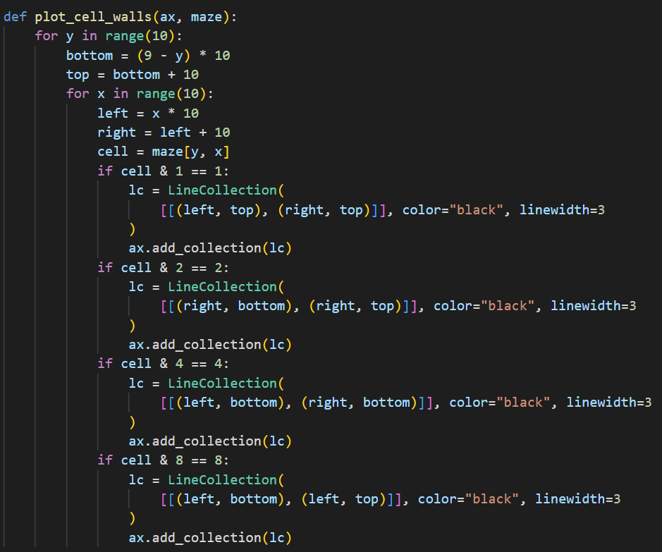
Open maze_draw.py
①
②
③
④
⑤
⑥
⑦
⑧
⑨
⑩

Slide 18
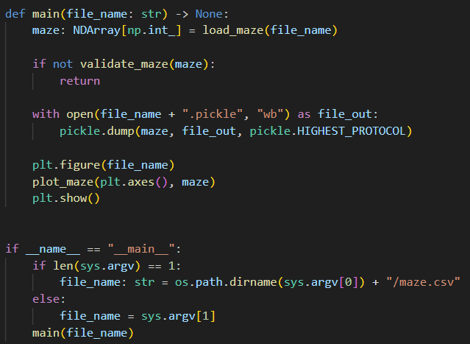
View maze_draw.py
⑤
⑥
⑦
⑧
⑨
⑩
①
②
③
④

Slide 19
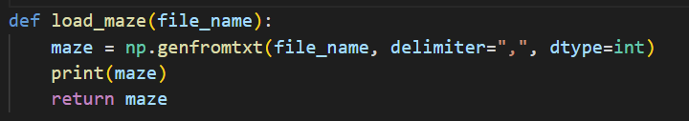
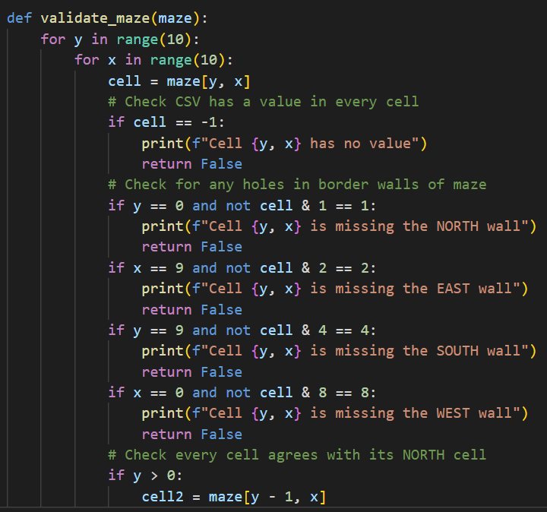
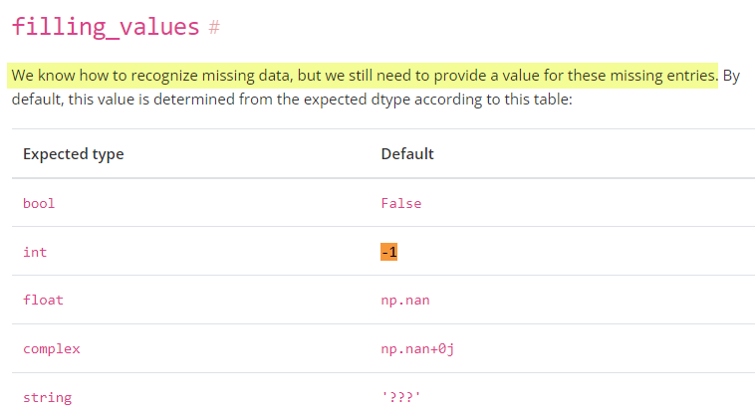
View maze_draw.py
①
②
③
④
⑤
⑥
numpy genfromtxt()
⑦

Slide 20
Run maze_draw.py
☺

Slide 21
Depth-First Search
Depth-first is a sequential search algorithm
It is just you alone in the maze, you have no helpers
It is a zero-prior knowledge, recursive, backtracking approach
You have breadcrumbs to mark your cell visitation history
Order of step search in each cell is North, East, South, West
We can only proceed in a direction if there is no wall in the path:
if (cell value & direction) != direction
North (1) → (Δ row = -1, Δ column = 0)
East (2) → (Δ row = 0, Δ column = 1)
South (4) → (Δ row = 1, Δ column = 0)
West (8) → (Δ row = 0, Δ column = -1)

Slide 22
Depth-First Search Algorithm
Drop a breadcrumb (Post-it Note) as you enter each cell
Take a step in the very first direction that is open, and go to step #1
If there are no more open directions in the cell, retrace your steps backwards until you reach a cell with a breadcrumb (Post-it Note) where the next open direction is one you have not taken yet
Write the new direction on the Post-it Note, take a step in that new direction, and go to step #1
Stop with you reach the exit square

Slide 23
Depth-First Search Breadcrumbs
A breadcrumb matrix (array) could contain a simple bool value to indicate if you have previously visited this cell
Breadcrumbs prevent going around in endless circles and never finding the exit
But in this program, we maintain a list of tuples called steps where each tuple equals (y, x, last direction tried) for each step along the current path – this is how we track the latest Post-it Note value in each cell
Lots of backtracking in the path indicates an inefficient search pattern, because you are visiting the same node too many times!

Slide 24
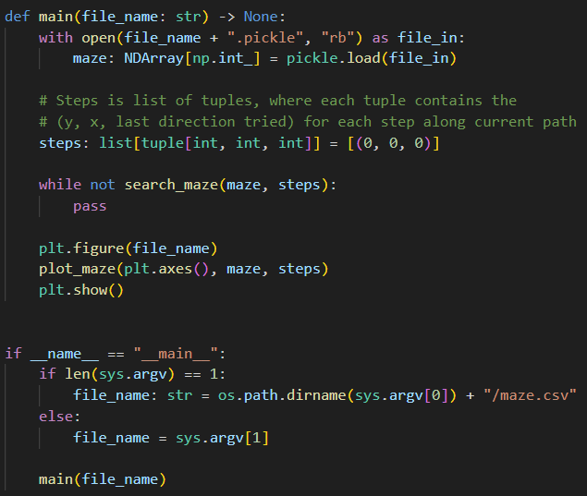
Open maze_search.py
⑤
⑥
⑦
⑧
⑨
⑩
①
②
③
④

Slide 25
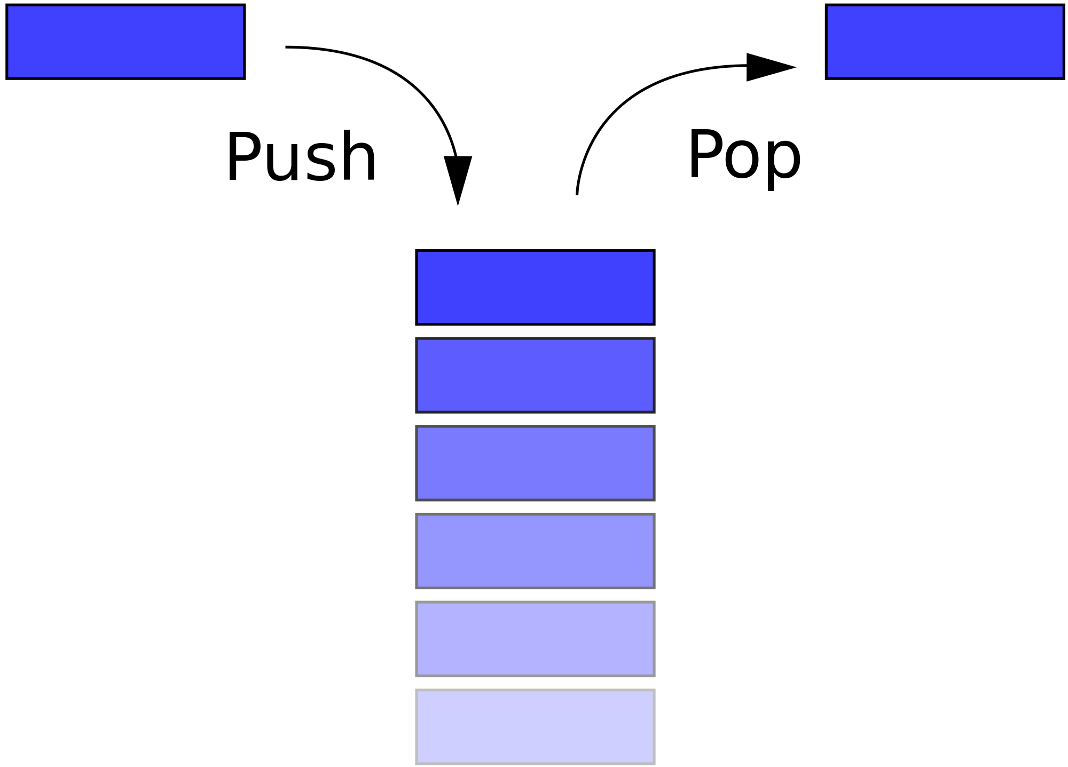
Depth First Search Breadcrumbs
Entrance
pop()
pop()
We use a “stack” data structure to record the [row][col] of the navigator at each step through the maze

Slide 26
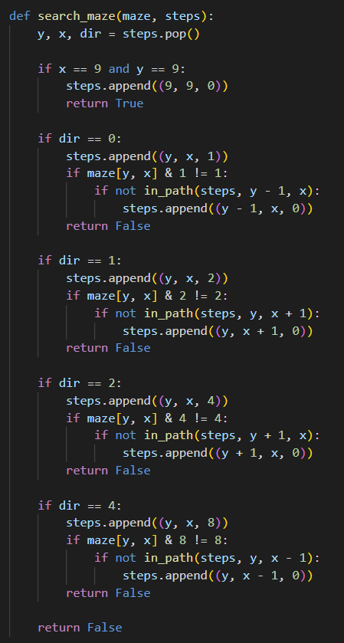

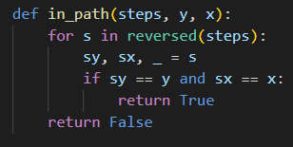
View maze_search.py
①
②
③
④
⑤
⑥
⑦
⑧
⑨
⑩
①
②
③
④
⑤
⑥

Slide 27
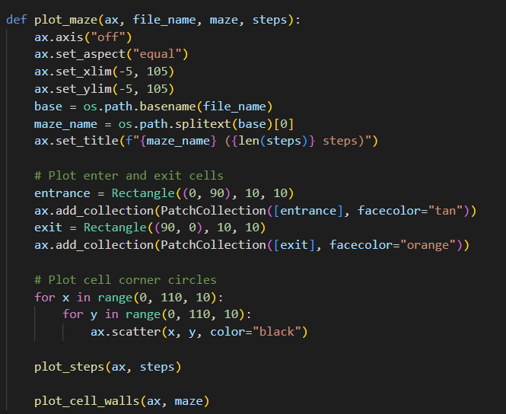
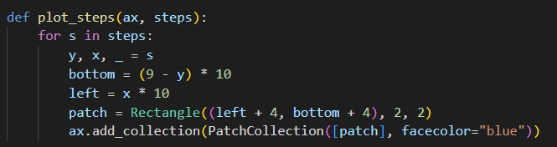
View maze_search.py
①
②
③
④
⑤
⑥
⑧
⑨
⑦
⑩

Slide 28
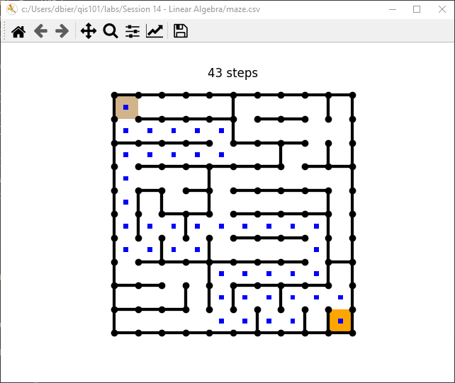
Run maze_search.py

Slide 29
Improving Depth-First Search Efficiency
The unaided depth-first search spends considerable time exploring paths which clearly are not on the optimal route – it hits a lot of dead ends
What if we could calculate the shortest path length, and start backtracking the instant our current path length ≥ the shortest path length?
It is possible to calculate the minimum number of steps from entrance to exit (the shortest path) without searching one cell or taking one step!

Slide 30
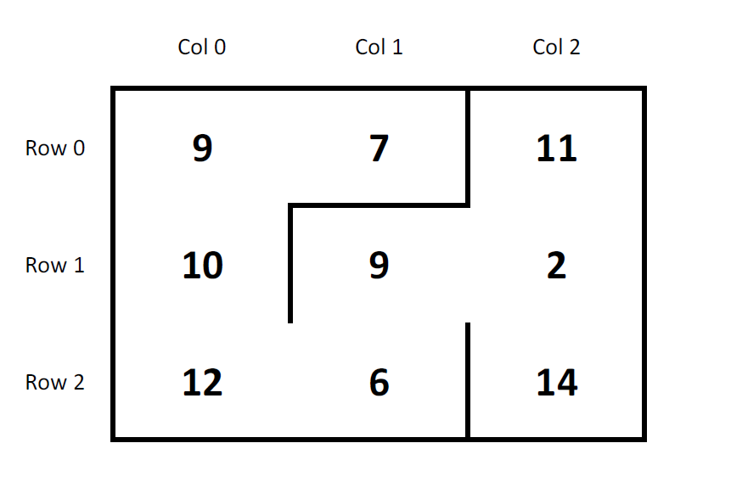
Adjacency Matrix
3 x 3 maze
9 total cells

Slide 31
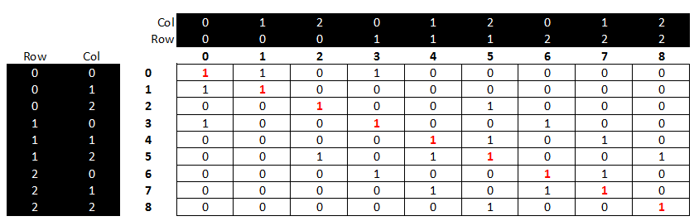
Adjacency Matrix
Every maze square (cell) is represented along both
the rows and columns of an adjacency matrix
A True (1) indicates you can reach the other cell in just one step
A False (0) means that you cannot reach the other cell in just one step

Slide 32
Adjacency Matrix
The main diagonal has all True values
because every cell can reach itself by definition
1 = True
0 = False
The whole matrix is symmetric about the main diagonal
because there are no “one-way” doors in the maze.
Reflexive Property: If you can get from cell A to cell B in one step,
then you can also get from cell B to cell A in one step

Slide 33
Adjacency Matrix
To find the shortest path length, we keep ANDing (using the logical operator) the adjacency matrix against itself until a True value appears in the matrix element that represents the exit cell
The number of times we had to “multiply” (AND) the adjacency matrix by itself equals the minimal # of steps from entrance to exit
Ironically, we can know the # of steps in the shortest path, but not what the actual steps are!
But how do we "logically" multiple two matrices together?

Slide 34
Adjacency Matrix
If it is True you can get from A to B, and it is True you can get from B to C, then it must be True that you can get from A to C (transitive property)
When “multiplying” Boolean adjacency matrices, if the AND of all the elements in (Row A x Col B) is == True then the cell is set to True
We keep multiplying the adjacency matrix until a True appears in the cell that represents the exit square.
The total # of matrix multiplications required = the shortest path length from entrance to exit

Slide 35
Adjacency Matrix
We can calculate the adjacency matrix before starting a depth-first search
We can then use this shortest path length to limit the current search path to improve the efficiency of the search
Once the current len(steps) has more items than the shortest path length calculated from the adjacency matrix, we must start backtracking!
There is no reason to continue a path which has a step count greater than the known shortest path – it’s best to backup and try a new direction

Slide 36
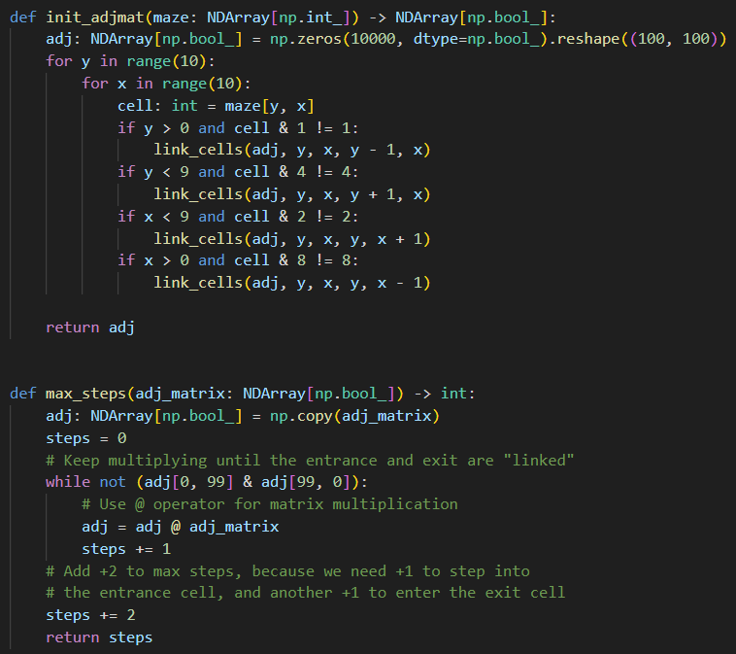
Open maze_adjacency.py
①
②
③
④
⑤
⑥
⑦
⑧
⑨
⑩

Slide 37
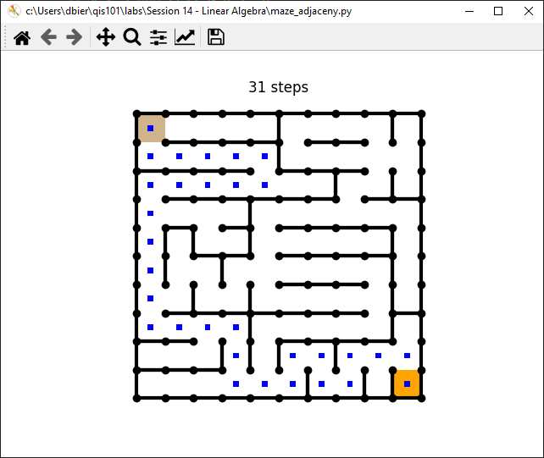
Run maze_adjacency.py

Slide 38
Adjacency Matrix
On average using an adjacency matrix reduces the steps in a depth-first search by 30% !
Path Steps = 43
Path Steps = 31

Slide 39
Session 14b – Now You Know…
How to encode 2D maze walls in base 2
In Python a [Y][X] matrix means there are Y rows and X columns
The bitwise AND (&) operator can decode wall values
Depth-first search is implemented with recursion or a stack
You must use a breadcrumbs array to prevent infinite loops
A Boolean adjacency matrix can be used to calculate the length of the shortest path from entrance to exit
However, the adjacency matrix will not identify the actual steps along that shortest path
Leveraging the adjacency matrix during a depth-first search will yield on average a ~40% improvement in the efficiency of the search

Slide 40
Task 14-03
Create a 2D maze and then "complicate" it
Edit key cells in your matrix so the solver must take the greatest number of steps to navigate from the start cell to the exit cell
What makes a maze complex? It is a careful balancing act:
Long straight alleys require backtracking but limits choices and may make navigation easier
Wide open junctions (no cell walls) may require the solver to try more directions, but it may also be easier to navigate straight through to the exit
Does the complexity depend upon the search strategy?
Bonus points for the person who creates the hardest maze!
Upload your complicated maze.csv.pickle file to the BNL QIS101 SharePoint site

Slide 41
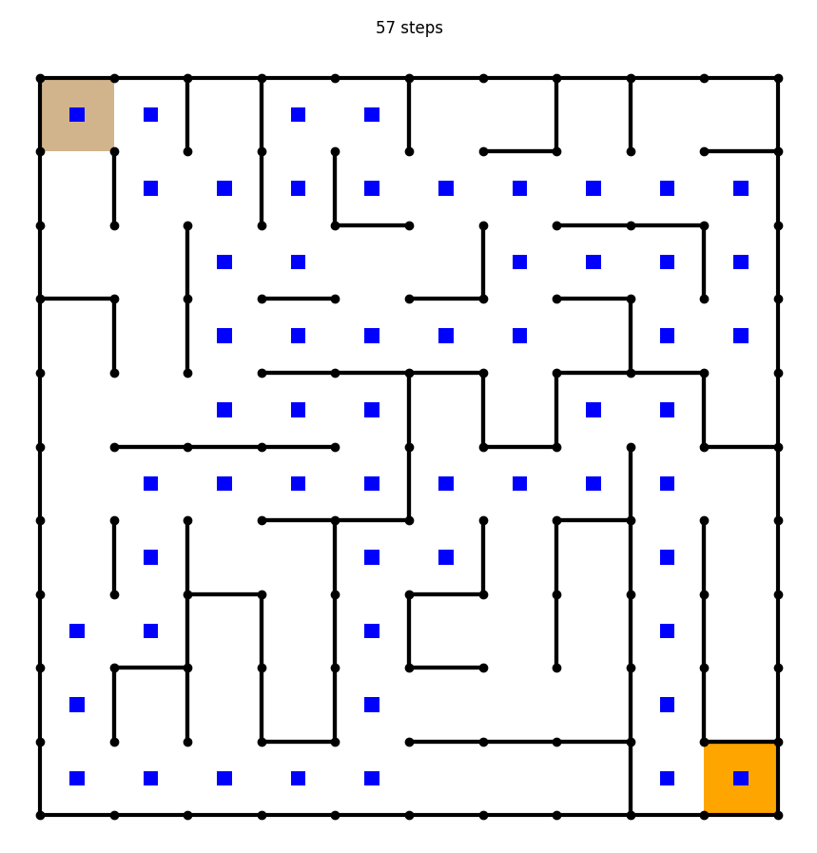
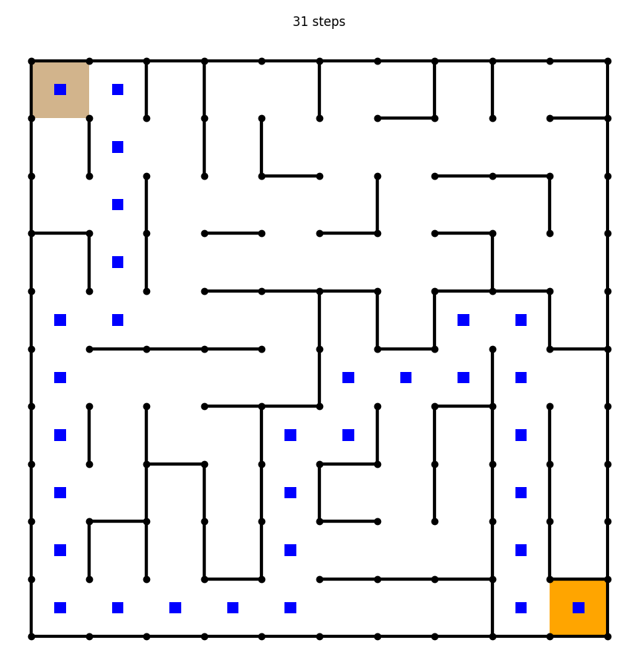
Using an adjacency matrix reduces the step count by 45%

